Slide 1

CANARA ENGINEERING COLLEGE Sudhindra Nagara, Benjanapadavu, Mangalore– 574219, D.K Karnataka
DEPARTMENT OF COMPUTER SCIENCE AND ENGINEERING
GENERATIVE AI POWERED MODERN EDUCATION TOOL TO ENHANCE TEACHING- LEARNING EXPERIENCE
Pratheek Nayak B K 4CB21CS072
Shivani A S 4CB21CS102
Skanda B H 4CB21CS110
V Suraksha Pai 4CB21CS120
GUIDE: Prof. Babitha Ganesh Kulal
Evaluation Date:24-10-2024

Slide 2
Content
Introduction
Problem Definition
Objectives
Literature survey
Functional and Non-Functional requirements
Design Constraints
Conclusion and Future Scope
Bibliography

Slide 3
INTRODUCTION
Enhances Traditional Learning: An extension of the traditional teaching approach to increase its effectiveness.
Differential Experiences of Learning: Promotes personalized learning, designed to suit individual requirement and preference.
Building Adaptive Learning Culture: Strives to develop an effective and responsive learning environment in terms of the given forms of needs for learning.
Saves time for Virtual mentoring and immersive environments : Provides excellent interactive experiences that bring about a dynamism of learning.

Slide 4
PROBLEM DEFINITION
Problems faced by students:
Traditional methods lack the flexibility to allow for hands-free control and efficient problem solving.
Time consumption:
Tutors/Educators spend more time creating study resources for students.
Need/Solution:
There is a need of an educational platform that not only helps students rather helps tutors by providing more interactive and interesting way of teaching students.
Teach hands-free via voice commands/assistance unlike traditional way of teaching using chalk and board

Slide 5
Objectives:
1) To create a modern education tool integrated with generative AI to enhance the overall quality of the education.
2) To implement handwriting recognition system by integrating real time OCR system.
3)To implement the robust voice command system that allow teachers to interact with platforms hands free.
4)To incorporate Natural Language Processing(NLP) to automatically correct and suggest improvement in the text providing teachers with real time feedback.

Slide 6
LITERATURE SURVEY:
Project Title and Author | Problem Addressed | Implementation and Results | Limitations/Future Scope
Educational Use of Voice Assistants and Smart Speakers By Thanasis Tsourakas, George Terzopoulos*and Stefanos Goumas. | Voice assistants boost access and engagement of students who are struggling with classes. | The devices can be used for interactive classes or questions, reminders, and as an interactive assistant to recite problems. | Some of the data privacy issues and diverting their attention during classes.
EnvisionText: Enhancing Text Recognition Accuracy through OCR Extraction and NLP-based Correction By Aditya Singh, Sahil Jangra ,Garima Agarwal | Improvement of accuracy in the recognition of text under difficult conditions. | This integrates the OCR extract with the correction that NLP brings forth. | Error rate reduces with context understanding increased. Quality-dependent; better preprocess and multilingual support to be selected in future.
Prompting the E-Brushes: Users as Authors in Generative AI By Yiyang Mei1 | Conventional con-tent creation has confined user creativity and involvement. | Generative AI tools allow the users to create novel content using interesting prompts. | Quality check and bias control would be big constraints. For the future, research in the area of user interfaces and applications in creative do-mains should focus on these areas.

Slide 7
LITERATURE SURVEY:
Project Title and Author | Problem Addressed | Implementation and Results | Limitations/Future Scope
Voice Assistants and Smart Speakers in Everyday Life and in Education By George TERZOPOULOS, Maya SATRATZEMI | The traditional tech interactions reduce accessibility and participation. | Integrated into homes and classrooms for hands-free interaction and task assistance. Improved convenience and engagement, thus enhancing access to information and the learning experience. | Privacy issue as well as variation in familiarity with tech. Future research should im-prove functionality and eliminate security issues.
Chalk-Free Instructions through Hand Gestures: Bridging the Gap in Digital Education By Atharva Hoshing, Rakhi Bharadwaj, Shreyash Bandi, Prathamesh Aldar, Rushikesh Borse, Purvesh Ahire . | The traditional way would not have allowed interactive digital education. | Hand gesture recognition was an interactive presentation in chalk-less presentations. The students were much more interested and understood the topic far better. Reactions were mostly positive. | This technology suffers from precision and availability of technology; such research should enable the technology to be refined and assess if it works well with people of different ages and across diverse lo-cations.

Slide 8
LITERATURE SURVEY:
Project Title and Author | Problem Addressed | Implementation and Results | Limitations/Future Scope
Artificial Intelligence-based Voice Assistant NLP-Based Personal Learning Assistant for School Education By Ann NeethuMathew1, Rohini V.2,Joy Paulose3 | How voice commands enhance user interaction and accessibility. The nature of the challenge between personalized learning and the dismal understanding of the students to be filled | AI voice assistant, using NLP and machine learning, for helping user queries. User engagement and the rate of completing tasks increased. Development of an NLP-based assistant that can be used to aid and adapt the content accordingly for the individual needs. Higher engagement and results in the eyes of the end users, self-reported better understanding. | It is limited by language support; future work may include the enhancement of multilinguality and contextual under-standing. The challenges surrounding ac-curacy and data privacy. In the furthering of there search, the assistant can be refined, and further educational applications can be explored

Slide 9
LITERATURE SURVEY:
Project Title and Author | Problem Addressed | Implementation and Results | Limitations/Future Scope
Generative AI in Education and Research: Opportunities, Concerns and Solutions By Eman A. Alasadi and Carlos R. Baiz* | Personalization and Quality of Content . | Generative AI tools are developed for customized learning content and augmenting capabilities in research work. Users engaged more and learned better with AI-generated content. | Biases and Ethical issues. Future studies are needed to address the limits of this technology and look deeper into its expansive application in education and re-search.
Text Prediction And Autocomplete Using Natural Language Processing By Isha Shelke, Ritali Waghulde, Rutuja Gurav, Samira Sutar, Prof. Sarika Aundhakar. | Inefficiency in type-setting leads to disrupting workflow by users. | An NLP-based system was created that allowed for real-time text predictions and automatic correction suggestions. The system reduced typing time and errors, boosting productivity and user satisfaction. | Challenges include achieving better context accuracy and privacy apprehensions. New research areas could focus on enhancing prediction algorithms, and further functionality can be developed.

Slide 10
Literature survey:
Project Title and Author | Problem Addressed | Implementation and Results | Limitations/Future Scope
Air Canvas Using OpenCV And Media pipe By Neeraj Rajesh Javalagi, Sahil Patil, Yash Gunjal Shantanu Vaidya Tan-mayee Kute. | The traditional drawing techniques do not let any creativity or interactivity occur. | OpenCV and Media pipe used to con-struct an ”Air Can-vas” system that gave the user the ability to draw in the air using hand gestures. The system created better engagement and creativity through intuitive, real-time drawing experiences. | Challenges include accuracy in gesture recognition and environmental interference. This technology needs better detection and more features so that it can be used for various forms of art.

Slide 11
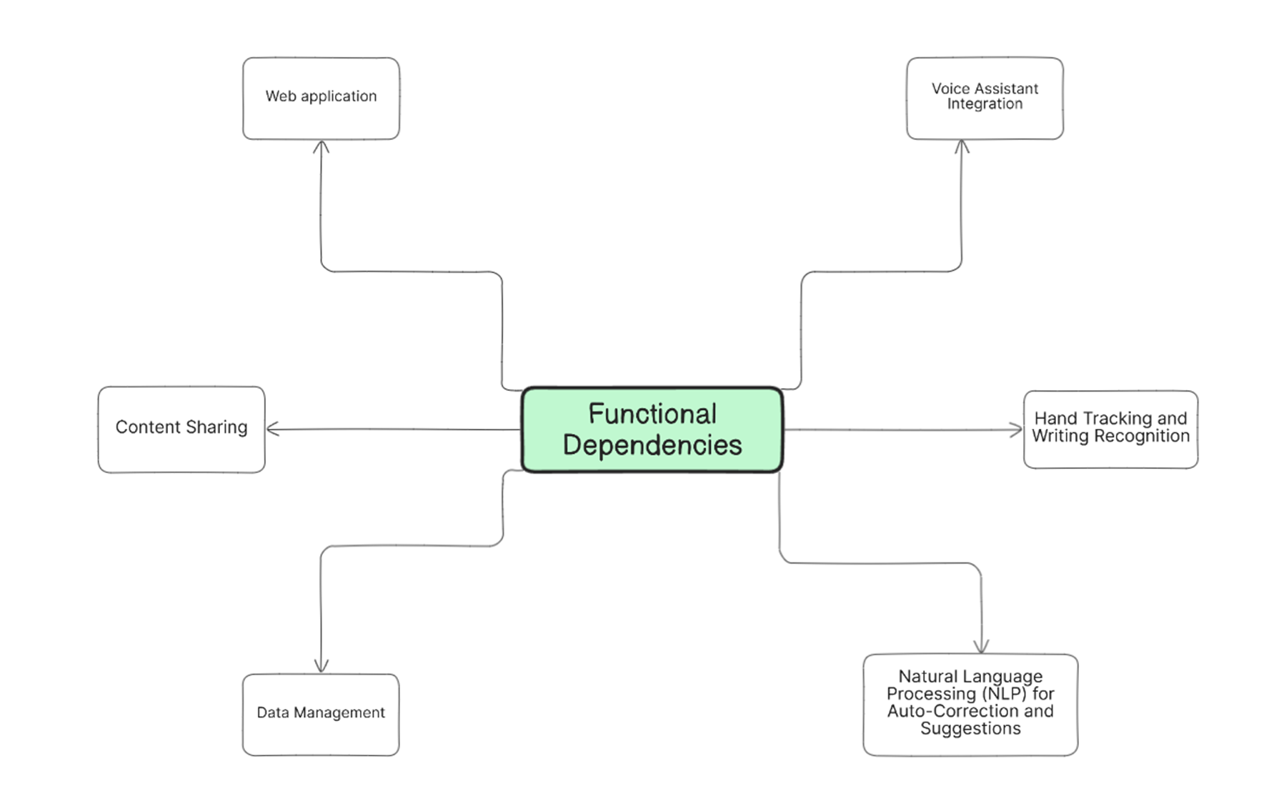
Functional and non-functional requirements
Functional Requirements:

Slide 12
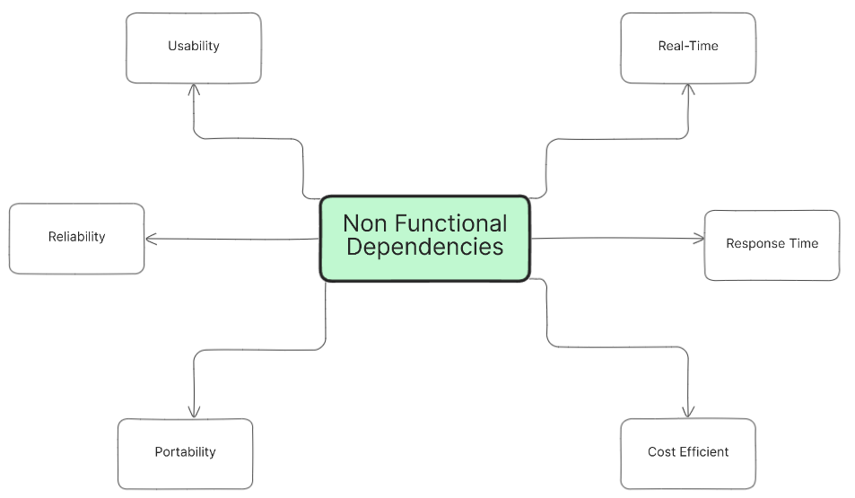
Functional and non-functional requirements (continued)
Non-Functional Requirements:

Slide 13
DESIGN CONSTRAINTS
Lighting Conditions: The system requires sufficient lighting to ensure accurate hand-tracking.
Clear Background: The system should be used in an environment with minimal background movement to avoid incorrect gesture recognition.
Real-Time Processing: The system must handle data processing for handwriting, gestures, and voice recognition in real time with minimal latency.
Voice Clarity: A quiet environment is preferred to prevent interference with the voice commands, ensuring accurate recognition.
Cross-Platform Compatibility: The system should work seamlessly on different operating systems (Windows and Linux).

Slide 14
Conclusion and Future Work
This application aims to integrate effective interactive learning, hands-free teaching/learning capabilities, and time-saving features to enhance the overall efficiency of the teaching and learning process.
Future scope:
Students monitoring system for tutors.
To make it a platform that allows multiple users to join an online session concurrently, ensuring broad participation and engagement.

Slide 15
BIBLIOGRAPHY
[1] Eman A Alasadi and Carlos R Baiz. “Generative AI in education and research:Opportunities, concerns, and solutions”. In: Journal of Chemical Education 100.8(2023), pp. 2965–2971.
[2] Atharva Hoshing et al. “Chalk-Free Instructions through Hand Gestures: Bridging the Gap in Digital Education”. In: ().
[3] Ann Neethu Mathew, V Rohini, and Joy Paulose. “NLP-based personal learning assistant for school education”. In: Int. J. Electr. Comput. Eng 11.5 (), pp. 4522–4530.
[4] Yiyang Mei. “Prompting the E-Brushes: Users as Authors in Generative AI”. In:arXiv preprint arXiv:2406.11844 ().
[5] Aditya Singh, Sahil Jangra, and Garima Aggarwal. “EnvisionText: Enhancing Text Recognition Accuracy through OCR Extraction and NLP-based Correction”. In:2024 14th International Conference on Cloud Computing, Data Science Engineering(Confluence). 2024, pp. 47–52. doi: 10.1109/Confluence60223.2024.10463478.

Slide 16
BIBLIOGRAPHY
[6] S Subhash et al. “Artificial Intelligence-based Voice Assistant”. In: 2020 Fourth World Conference on Smart Trends in Systems, Security and Sustainability (WorldS4).2020, pp. 593–596. doi: 10.1109/WorldS450073.2020.9210344.
[7] George Terzopoulos and Maya Satratzemi. “Voice assistants and smart speakers in everyday life and in education”. In: Informatics in Education 19.3 (2020), pp. 473–490.
[8] Thanasis Tsourakas, George Terzopoulos, and Stefanos Goumas. “Educational use of Voice Assistants and Smart Speakers.” In: Journal of Engineering Science & Technology Review 14.4 (2021)

